Slide 1
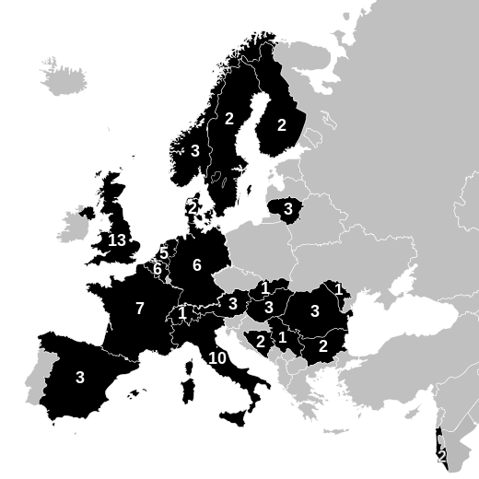
Collaborative European NeuroTrauma Effectiveness Research in TBI (CENTER-TBI)
38+7 Participants; > 80 scientists
>70 investigating centres
Precision medicine & Comparative Effectiveness Research
EU Framework Program 7 grant: €30 million
Coordinators: Maas & Menon

Slide 2
Logistics: enrolment & data collection
Centre profiling
Context of care – health care systems, institutional/unit characteristics
Population served, protocols, and practice
Core study (70 centres, 5400 patients; 1800 in each stratum)
ER stratum
Admission stratum
ICU stratum
Registry: (~20,000 patients)
Anonymised administrative data; regulatory approval to waive consent
For assessment of generalizability & impact of process variables
Substudies
MR : 23 centres; 1800 patients; 3 T (<72 hrs; 2-3 wks; 3/6 months)
High res ICU data: 20 centres; 200-400 patients (Moberg/ICM+)
Advanced haemostasis: ~20 centres (TEG/ROTEM; platelet function)
Electrocorticography (spreading depression [SD]; COSBID collaborators)
EEG: monitoring; automated seizure detection, correlations with SD
Embedded and associated studies

Slide 3
Principles underlying data sharing policy
Ethical and regulatory compliance
Procedures for ensuring data validity
An integrated data management plan which:
respects analytic integrity
avoids statistical penalties 2º to inappropriate early data mining
A dissemination strategy which:
recognises academic contributions
Allows maximal use of collected data
complies with publication ethics – or seeks to modify these

Slide 4
CENTER-TBI data use
CENTER-TBI data collection
Analyses in consortium plan
De-identified data publicly available
Associated studies
“Pre-emptive” data sharing
Ongoing/planned TBI studies
Range of PIs and funders
Full access to all our data
Access to biosamples
New consortia: GAIN
Regulated by external data use agreement
Extended to investigators from contributing centres:
Outline-Management Committee
Explore additional data collection
Discuss analysis with WP leader
Ancillary or independent analysis
Regulated by Consortium agreement

Slide 5
CENTER-TBI: Associated studies
Acronym | Study | Funder, PI
MetTBI | Identification of blood-based predictive metabolic markers of mild TBI | NineSigma Challenge $300,000 (+ $500,000) Matej Oresic (Denmark)
RESCUE-ASDH | Randomised Evaluation of Surgery with Craniectomy for patients Undergoing Evacuation of Acute Sub-Dural Haematoma | NIHR (UK) £1,445,618 Peter Hutchinson (UK)
COVER-TBI | Complete View on Essential Records in Traumatic Brain Injury | EU Horizon2020 €4,998,865 Mark van Gils (Finland)
MIND-TBI | Modelling and Integrating New Data in Traumatic Brain Injuries –a multidisciplinary systems medicine approach to a complex public health problem | EU Horizon2020 €5,817,103 Olli Tenovuo (Finland)
PROLABI | Protective ventilatory strategy in severe acute brain injured patients: a randomized control trial | University of Turin Luciana Mascia (Italy)
OXT-TC | PbtO2 guided treatment of TBI | University of Grenoble Payen et al (France)
EpiBios | Epilepsy Bioinformatics Study | NIH Vespa et al (USA)

Slide 7
need to address potential mismatches between
Opportunity, incentive, effort, and output
Resource allocation vs. resource needs for data sharing
Effort and academic rewards of data collection vs. analysis
Requirements on methods developers vs. data generators
Access and use of commercial vs. academic data
Ensuring public access vs. retaining commercial incentives
A new model of attribution: ADNI modification of BMJ policy (2012)?
Authors, Guarantors, Contributors*: *On behalf of the CENTER-TBI participants and investigators
Magnitude of effort in each category depends on publication

Slide 8
CENTER-TBI Drivers for data sharing
Disease heterogeneity drives need for large samples
Failure of conventional research paradigms (RCTs)
Success of past collaborative efforts (TCDB)
Increased access to funding through specific schemes
Compliance with funders requirements
Academic and societal peer pressure
Availability of global standards for data collection
Potential for methodological cross fertilisation
Increased statistical power to deal with difficult data
Generalizability of results across centres and countries

